Slide 1
Decision Trees & Random Forests

Slide 2
Review steps
Load data
read.csv()
Partition to avoid overfitting
sample(), df[idx, ] etc.
Exploratory Data Analysis
summary(), plot(), table() etc.
Prepare data for modeling
Vtreat:designTreatmentsC/N(), prepare()
5. Model
Regression, Logistic Regression, KNN etc.
6. Get Results (classification or prediction)
predict()
7. Key Performance Indicators
RMSE, Accuracy, MAPE

Slide 3
Review steps
Load data
read.csv()
Partition to avoid overfitting
sample(), df[idx, ] etc.
Exploratory Data Analysis
summary(), plot(), table() etc.
Prepare data for modeling
Vtreat:designTreatmentsC/N(), prepare()
5. Model
Regression, Logistic Regression, KNN etc.
6. Get Results (classification or prediction)
predict()
7. Key Performance Indicators
RMSE, Accuracy, MAPE
SAMPLE
EXPLORE
MODIFY
MODEL
ANALYZE

Slide 4
Agenda
Start | End | Item
 |  | Decision Trees - explanation
 |  | Decision Tree Example
 |  | A to Z Decision Trees scripting example
 |  | Break
 |  | Random Forests

Slide 5
Decision Trees
By observing the data and splitting it into sections, rules are created for either prediction or classification problems.
Mimics a subject matter expert…pre data mining days.
Before data mining, an experienced marketing bank manager may have said “let’s call our married customers over 25 that have at least a college education to see if they want another loan.”

Slide 6
Key Ideas
Recursive partitioning: Repeatedly split the records into two sections so as to achieve maximum homogeneity of outcome within each new section
Pruning the tree: Simplify the tree by pruning peripheral branches to avoid overfitting – measure and reduce complexity

Slide 7
Advantages of Decision Trees
Understandable, rules are human readable; executives love looking at them
Light weight, fast
Easy to implement…logic can be built in Excel even
Variable selection is automatic
No assumptions of data
Works with minimal data preprocessing

Slide 8
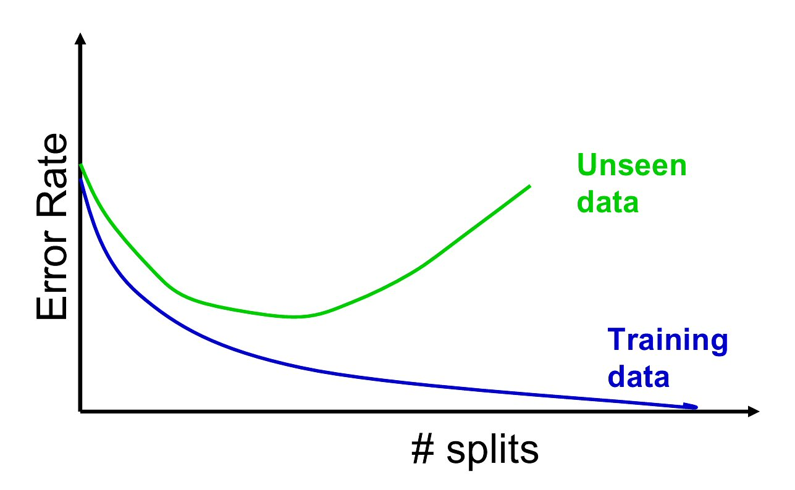
Disadvantages of Decision Trees
Overfitting!! You could create rules down to individual records so you get perfect accuracy (100% purity in each section). This wouldn’t generalize to new unseen data.
This is why having a training, test and holdout partition is important when making a decision tree. In production it is also important to review results of a model periodically to ensure the historical patterns aren’t evolving.

Slide 9
Recursive Partitioning Steps
Pick one of the predictor variables, x_{i}
Pick a value of x_{i,} say s_{i}, that divides the training data into two (not necessarily equal) portions
Measure how “pure” or homogeneous each of the resulting portions is
“Pure” = containing records of mostly one class (or, for prediction, records with similar outcome values)
Algorithm tries different values of x_{i,} and s_{i} to maximize purity in initial split
After you get a “maximum purity” split, repeat the process for a second split (on any variable), and so on

Slide 10
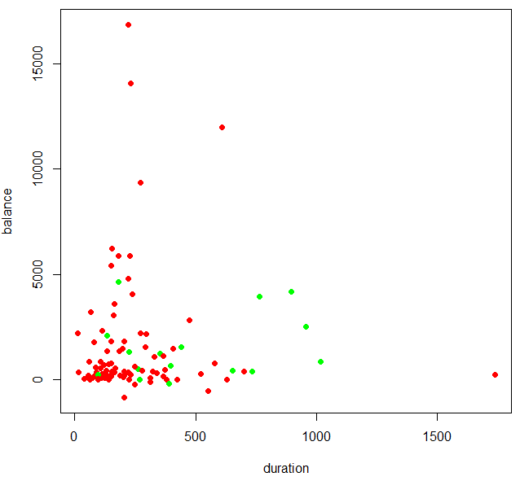
Suppose this is our data
Let’s classify offer acceptance among real bank customers using a decision tree. Green means they accepted the offer to open a new deposit account.
https://archive.ics.uci.edu/ml/datasets/bank+marketing

Slide 11
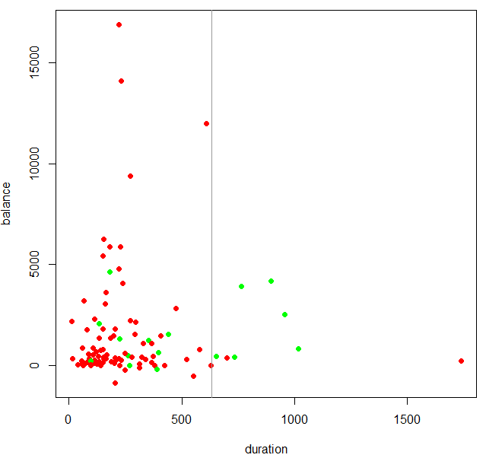
Suppose this is our data
Purity = 6 accepted among 8 offers
There are a lot of accepted offers with account holders of duration >635 days

Slide 12
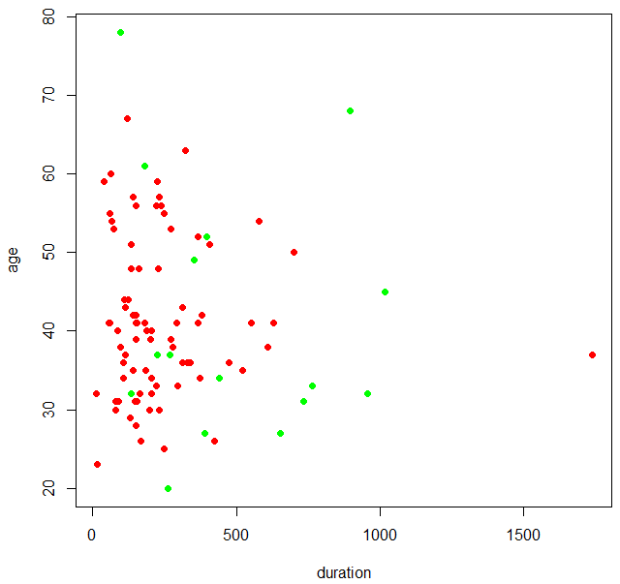
Now another view of the data
Here we see another dimension, age of the account holder along with duration.

Slide 13

With the rule duration > 635
The first rule still holds true but now we can think about adding new rule layers.

Slide 14

New Rule
A
B
Purity of split “A”= 6 accepted among 8 offers
Purity of split “B” = 1 of 1
In this toy example, we can add another rule stating age > 68 to capture another positive response and create another rule.

Slide 15
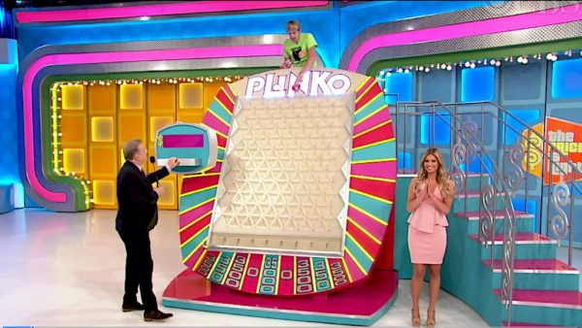
Our rule set is like Plinko!
With our rule tree we can score a new potential customer to call.

Slide 16
2 Rule Tree
Age > 68
No
Yes
Duration > 635
No
Yes
No (9 of 91 are positive)
Yes (6 of 8)
Yes
(1 of 1)

Slide 17
2 Rule Tree
Age > 68
Decision Node
No
Yes
Duration > 635
No
Yes
No (9 of 91 are positive)
Yes (6 of 8)
Yes
(1 of 1)
Terminal Node or “Leaf” Node

Slide 18
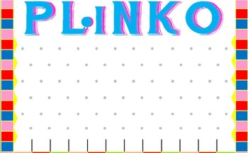
Let’s drop a new record down our plinko tree
Age > 68
No
Yes
Duration > 635
No
Yes
No (9 of 91)
Yes (6 of 8)
Yes
(1 of 1)

Slide 19
Let’s drop a new record down our plinko tree
Age = 39
Duration = 640
Age > 68
No
Yes
Duration > 635
No
Yes
No (9 of 91)
Yes (6 of 8)
Yes
(1 of 1)

Slide 20
Let’s drop a new record down our plinko tree
The age was less than 68 so the record drops to the next decision point.
Age > 68
Age = 39
Duration = 640
No
Yes
Duration > 635
No
Yes
No (9 of 91)
Yes (6 of 8)
Yes
(1 of 1)

Slide 21
Let’s drop a new record down our plinko tree
The duration is greater than 635 so the record lands at YES with a probability of 75% (6/8).
Age > 68
No
Yes
Duration > 635
No
Yes
Age = 39
Duration = 640
No (9 of 91)
Yes (6 of 8)
Yes
(1 of 1)

Slide 22
2 Rule Tree
Age = 39
Duration = 640

Slide 23
Let’s drop another record down our plinko tree
Age = 25
Duration = 365
Age > 68
No
Yes
Duration > 635
No
Yes
No (9 of 91)
Yes (6 of 8)
Yes
(1 of 1)

Slide 24
Let’s drop a new record down our plinko tree
The age was less than 68 so the record drops to the next decision point.
Age > 68
Age = 25
Duration = 365
No
Yes
Duration > 635
No
Yes
No (9 of 91)
Yes (6 of 8)
Yes
(1 of 1)

Slide 25
Let’s drop a new record down our plinko tree
Now the duration is less than 635 so the record drops to the terminal “NO” and has a probability of accepting the loan offer of ~10%
Age > 68
No
Yes
Duration > 635
No
Yes
Age = 25
Duration = 365
No (9 of 91)
Yes (6 of 8)
Yes
(1 of 1)

Slide 26
2 Rule Tree
Keep in mind a different algorithm may have come to a different conclusion…what about KNN? Also, adding more rules may find the local structure closer to this point so some judgment must still be made when constructing a tree.
Age = 25
Duration = 365

Slide 27
How a decision tree really splits data.
Order records according to one variable, say duration
Take a predictor value, say 600 (from the first record) and divide records into those with duration >= 600 and those < 600
Measure resulting purity (homogeneity) of class in each resulting portion
Try all other split values within the duration vector
Repeat for other variable(s)
Select the one variable & split that yields the most purity
Since it splits at various values within a single vector, there is no need to standardize (center, scale, normalize).

Slide 28
An example of overfitting…
2 rules still have some impurity in each section. Maybe we should keep adding rules.

Slide 29
An example of overfitting…
Adding this rule improves the purity
Age < 22

Slide 30
An example of overfitting…
These additional rules look like they help too.
Age > 62
Duration > 1100
Age < 22

Slide 31
An example of overfitting…
Great these rules are 100% pure! Our decision tree is perfect.
WRONG! Some of the rules were made for a single marketing offer. We fit to closely to the local structure so when we need to make a decision in the future this model wont be as accurate!
Age >38
Age <39
Duration >225
Duration < 300
Perfect node, but this is a rather specific customer case.

Slide 32
cp- complexity parameter
The cp value measures the size of the tree compared to its ability to separate the data. The tree will grow until the next split doesn’t reduce the cp value…meaning that split added more complexity than is gained from the purity of the node.
Setting cp to a negative amount ensures that the tree will be fully grown.

Slide 33
Open 1_Bank Loans Decision Tree.R

Slide 34
Agenda
Start | End | Item
 |  | Decision Trees - explanation
 |  | Decision Tree Example
 |  | A to Z Decision Trees scripting example
 |  | Break
 |  | Random Forests

Slide 35
Framework for Business Results
Scope
Business Results
Quality
Time
Notes:
Usually get two.
Building a

Slide 36
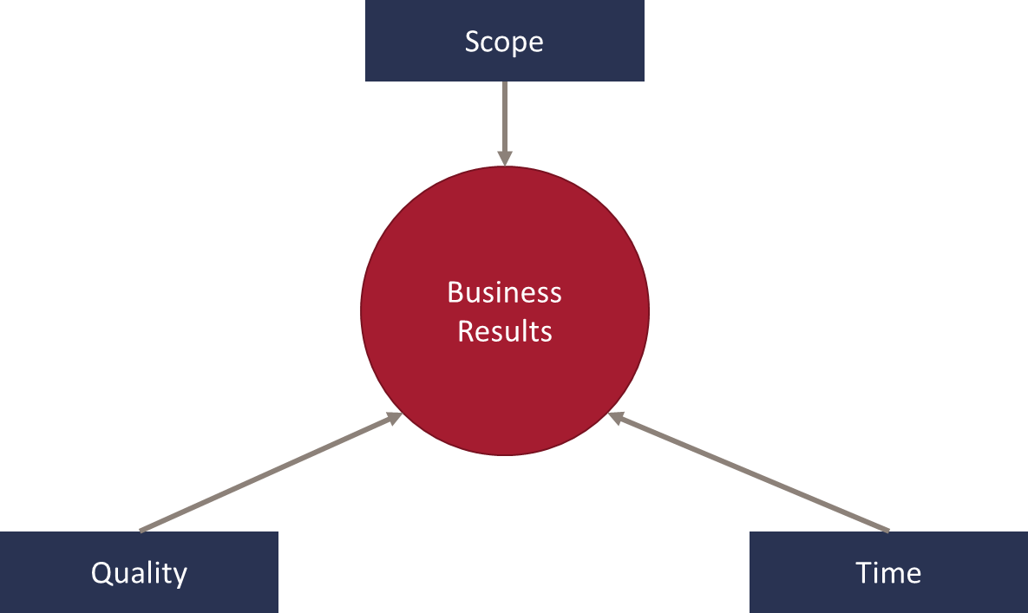
Building a Bridge Example
Scope
From Point A to B
Pavement
Signs
Traffic Divider
Lane Markings
Lighting
Sidewalk
Fencing
Nets to catch suicides
Flood Resistant
Toll Booth
Train underneath
…

Slide 37
Building a Bridge Example
Quality
Safe for cars, pedestrians
Stands up to inclement weather
Earth quake proof
Guaranteed for X years

Slide 38
Building a Bridge Example
Time
Build it in 1 yr
2yrs
4 yrs – Golden Gate Bridge
??

Slide 39

Business Projects get 2 of 3…choose wisely.
Quality
Scope
Time

Slide 40

1st Generation Kindle
Ability to deliver millions of books remotely.
Scope
How good is an e-reader without the ability to deliver books remotely?

Slide 41
1st Generation Kindle
Scope
Time
Kobo & nook launching, need to launch fast.
As a new market, Amazon wanted first mover advantage.

Slide 42
1st Generation Kindle
Quality
Scroll wheel & keyboard user interface breaks easily
Do current e-readers have a scroll wheel or keyboard?

Slide 43

10yrs & 16 changes…
https://techcrunch.com/2017/11/20/how-the-kindle-was-designed-through-10-years-and-15-generations/

Slide 44
In Data Science Modeling Results are similar
Algorithm chosen
Modeling Results
Training Data
Parameters Chosen
Notes:
What are some example of parameters you want to try in KNN? Decision Tree? – each of these iterations takes TIME
What happens to a model if the data is incorrect? Adding too much data is good or bad for linear models? - do you have to exercise judgment when selecting data?
We have learned some not all algorithms and know that each approaches “learning” differently.
A DS usually needs to have data be paramount and then selects algo’s she knows best. And due to time constraints cant test all algos, parameters and input data!

Slide 45
Modeling Results
Algorithm chosen
Modeling Results
Training Data
Parameters Chosen

Slide 46

Champion Vs Challenger!
Open
2_Bank Loans Algo Comparison.R

Slide 47
Agenda
Start | End | Item
 |  | Decision Trees - explanation
 |  | Decision Tree Example
 |  | A to Z Decision Trees scripting example
 |  | Break
 |  | Random Forests

Slide 48
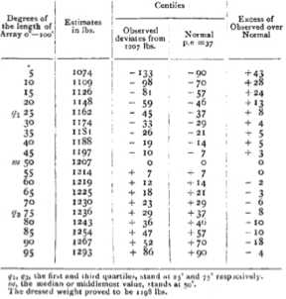
Random Forests…the Wisdom of the Crowd
1907 Vox Populi by Sir Francis Galton created the notion of “wisdom of crowds” as a phenomenon. It is the basis of modern search engines and crowdsourcing.
Prevailing wisdom at the time was that crowds acted irrationally
Riots, mobs, cults
Galton wanted to explore trustworthiness and peculiarities of popular judgment
Galton attended an Ox weight guessing competition at a cattle exhibition
Participants individually guessed a very wide weight range
The median weight was 9lbs (0.8%) off and was better than individual cattle experts.

Slide 49
Conditions for Wisdom of Crowds
Some machine learning methods behave like the cattle weight guessing participants.
For people:
Each individual member or voter must have an independent source of information (examine the cattle for themselves)
Make an individual guess not swayed by others (avoid group think or be blind to others’ guesses
Mechanism must be in place to collate and organize the diverse votes.
For algorithms:
Each individual method needs to be blind to the others in construction
Each individual classification or vote is therefore independent
Aggregation/tabulation is easy in an computerized environment.
Many of today’s best algorithms mimic a weak learner approach.

Slide 50
Random Forests
Each mini tree acts as a voter from the mob. Each voter is allowed to look at a random group of variables e.g. a mini data set to make its splits.
This toy example shows 2 variables were selected for each voter from among beds, baths, sqft and price. An individual tree may choose beds/baths while another may get beds/sqft and still another gets sqft/price.
A random forest grows many many classification trees
Variable combinations are selected randomly to create the forests but the number of variables or attributes needs to be specified
Each unknown value is then put through each tree to provide a final classification
Each tree then casts a vote for the unknown value.
Each “dumb” learner gets a vote that is tabulated so the wisdom of the mob can be identified.
East
West
East
West
East
East
Vote Tally
East | West
4 | 2
Since each tree focuses on a random combination of variables and random rows (boostrap), some trees will be more accurate, others less so. In total the splits will identify most informative variables, the ones that are usually split upon and with enough trees the group wisdom is found.

Slide 51
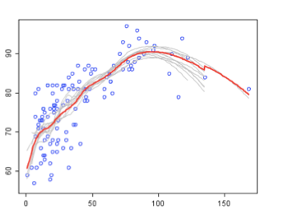
Random Forests
Fictitious Visual
Data Science Considerations
Group
Consensus
How many trees/voters?
How many decision points (nodes)?
How many features are allowed to be used in each random?
How to account for missing values?
Class A
Weak
Learners
Class B
In this example, each decision tree tries to separate the data and by taking the most numerous outcome (tally) the best outcome is often found. Since they are weak learners (not a lot of depth and with fewer variables) among hundreds, overfitting is usually less of a concern.

Slide 52
How a random forest is really grown.
Draw many re-samples of cases from the data (boostrap)
For each re-sampled set use a random subset of predictor variables to produce a tree. Some parameters include
Number of trees to grow – dictates the number of re-sampled sets
Number of predictor variables for each tree
Combine the predictions/classifications from all the trees (the entire forest)
Votes are tallied for classification problems
Predictions are averaged for continuous problems
Since it has many weak learners, overfitting is less of a concern.
Since its fitting many hundreds of trees, it takes some time to train a model.

Slide 53
Open Bank Loans RandomForest REVISED.R

Slide 54
Summary
Classification and Regression Trees are an easily understandable and transparent method for predicting or classifying new records
A single tree is a graphical representation of a set of rules
Tree growth must be stopped to avoid overfitting of the training data – cross-validation (CV) helps you pick the right cp level to stop tree growth – will cover CV later if time
Ensembles (random forests, boosting) improve predictive performance, but you lose interpretability and the rules embodied in a single tree

Slide 55


Your Data Mining Toolbox
Previous Lessons
Some R Programming (R-studio)
EDA (summaries, column and row exploration)
Knowledge of Data Preparation (vtreat)
Basic Visualization (plot, ggplot)
Linear Regression (continuous)
Logistic Regression (Binary Classification)
KNN (continuous & classification – binary or multi)
Today
Decision Tree (classification, continuous)
RandomForest (classification, continuous)
DT & RF are excellent modeling tools. Not bad for 6 weeks!

